Slide 1


New Service Tiers & People Science AI

Slide 2

The Double-Sided Problem
HR
Teams
At full capacity, so unable to support all People Leaders proactively.
People
Leaders
Limited expertise to analyze and digest survey results to prioritize actions.
People Science AI
Summarize key insights and advise recommend area of focus.

Slide 3



Key Features
PEOPLE SCIENCE AI
EXEC SUMMARY
PEOPLE SCIENCE AI
DEPARTMENT SUMMARY
GUIDANCE AND
EDUCATION AI
Our Human AI Avatar delivers a unique People Science executive-level summary for every survey.
Based on our Expert-Trained AI Model, which is built on over 1 million hours of employee engagement expertise, specifically tailored for interpreting engagement data.
Our WorkBuzz AI delivers detailed People Science text summaries for managers and department levels
Summaries use our specialized AI model, incorporating insights from over 1 million hours of employee engagement expertise, customized specifically for departmental and managerial insights.
Comprehensive support for all users throughout the WorkBuzz platform powered by People Science AI.

Slide 4
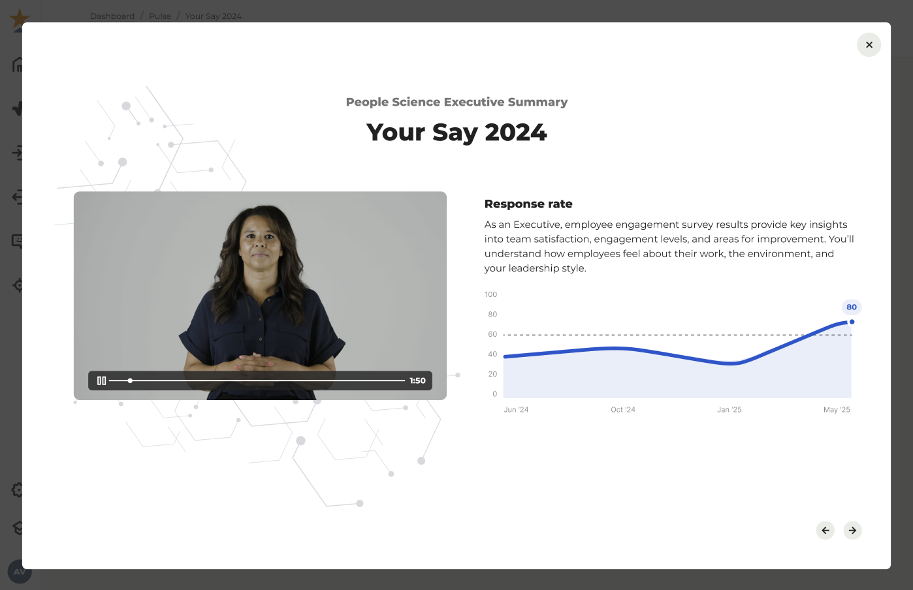
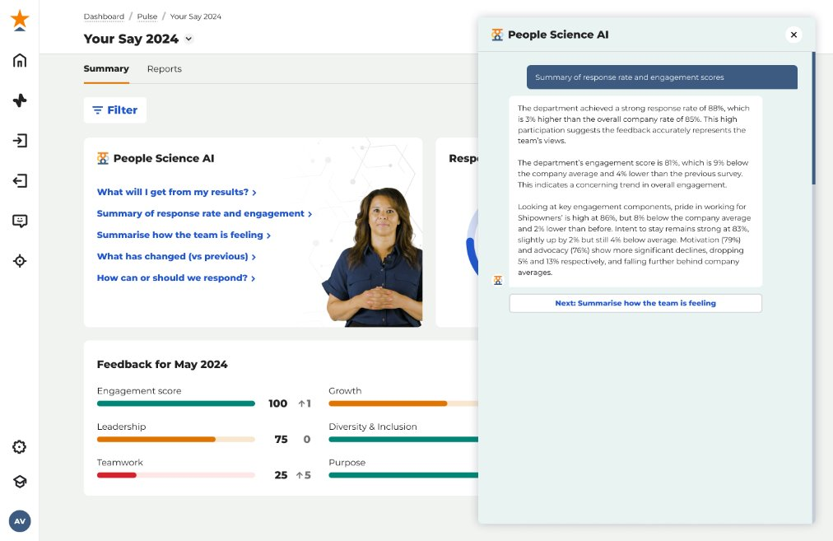
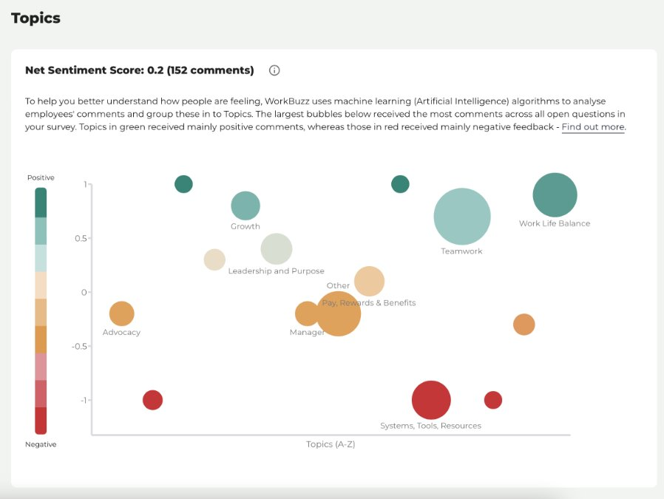
People Science AI
The WorkBuzz you love - now with added intelligence.
EXEC
SUMMARY
DEPARTMENT
SUMMARY
COMMENTS
ANALYSIS
Generate shareable executive-level survey summaries, using our Expert-Trained AI Model which draws on over 1 million hours of Employee Engagement expertise.
Empower your People Leaders with department-based summaries and action plans - pinpoint priority areas at the click of a button.
Instantly analyse open-text comments and consistently understand key topics and sentiment without the need for manual review.

Slide 5
People Science AI – Executive Summary
Generate shareable executive-level survey summaries, using our Expert-Trained AI Model which draws on over 1 million hours of Employee Engagement expertise.

Slide 6
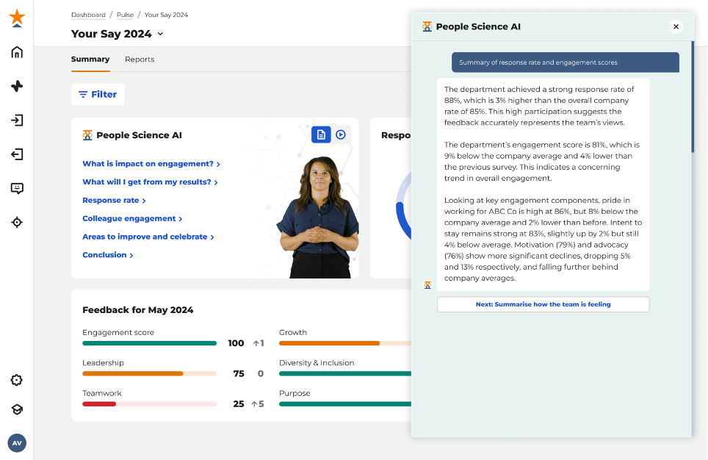
People Science AI – Department Summary
Empower your People Leaders with department-based summaries and action plans - pinpoint priority areas at the click of a button.

Slide 7

People Science AI – Comments Analysis
Instantly analyse open-text comments and consistently understand key topics and sentiment without the need for manual review.

Slide 8
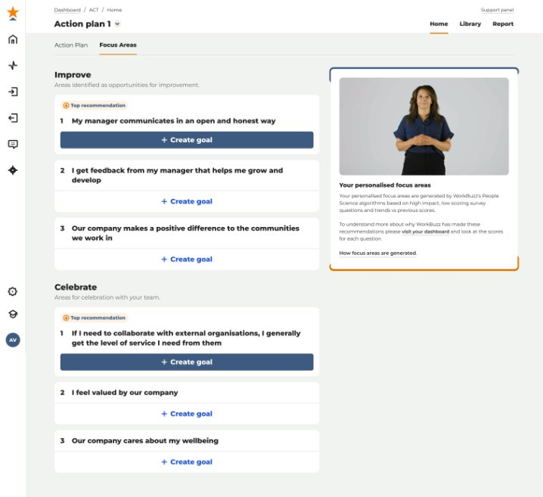
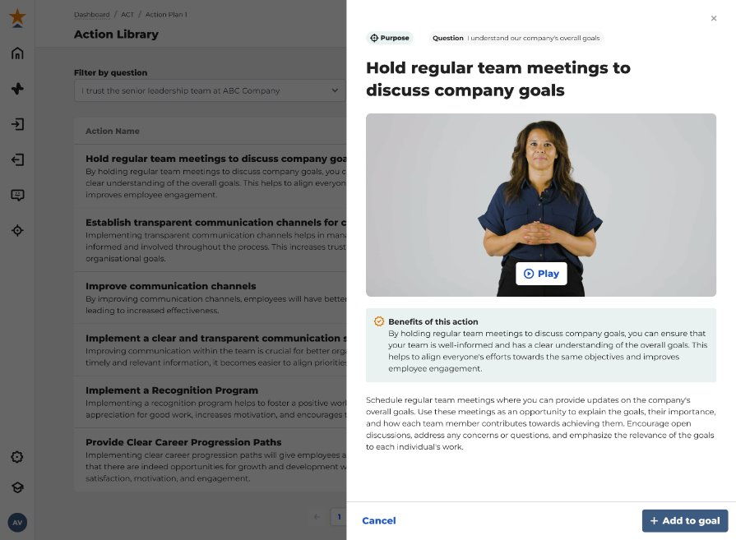
People Science AI – Dashboards & ACT
Create multi-language dashboards and action plans to support line managers in their native language.

Slide 9
People Science AI – Open API
Centralise your employee data for in-depth analysis and trend spotting.
Endpoint: Available Surveys endpoint
Endpoint: Respondent
Endpoint: Demographics
Shows all available open surveys for the user (Pulse, Lifecycle)
Example use case: Hapi (Personal Group’s platform) calls our Available Surveys endpoint and we return either the email URL or the Kioks URL (authenticated and non-authenticated) for them to display in their platform to their user
Add / Update respondents
Link Demographics
Connect a respondent to a department
Add new demographics
Endpoint:
Hierarchy/Departments
Endpoint: Distribution
Create / amend / rename / change parent / delete
New customers create every dept then update again once we generate parent ID
Add users to lifecycle

Slide 10

Plans
Plans to suit different sizes of businesses based on their employee engagement journey.
Foundation
Everything you need to kick start meaningful employee feedback and begin your listening journey.
Key features:
Unlimited surveys - Annual, pulse and on demand polls
Customisable questions and best practice templates
In-depth reporting and insights
Education & Guidance
Grow
Your upgraded toolkit for richer insights and more impactful, actionable employee feedback.
Key features:
Everything from Foundation +
Onboarding & Exit Surveys
Multi language surveys
Automated Action Planning with Focus Areas and task management
SFTP
Advanced
Harness the power of AI to accelerate decision-making and unlock deeper employee insights.
Key features:
Everything from Grow +
Multi language reports dashboards
People Science AI Summaries - Executive & Department Level
Open API
WorkBuzz Plus
Designed for:
Organisations ready to take employee engagement to the next level.
Receive dedicated support from your Customer Success Manager, run surveys in multiple languages, and use AI-powered text analytics to explore open comments in more depth.

Slide 11

New UK Pricing
 | Foundation | Grow | Advanced
Minimum Fee | £3,999 | £5,999 | £8,999
No. Of employees
100 | £3,999 | £5,999 | £8,999
250 | £8,199 | £10,499 | £13,821
500 | £12,699 | £15,499 | £19,371
1000 | £19,699 | £23,999 | £29,696
2500 | £30,199 | £38,999 | £50,996
5000 | £42,699 | £61,499 | £80,996
10000 | £62,699 | £86,499 | £112,246
Pricing Table

Slide 12
New US Pricing
 | Foundation | Grow | Advanced
Minimum Fee | $4,999 | $6,999 | $9,999
No. Of employees
100 | $4,999 | $6,999 | $9,999
250 | $10,249 | $12,624 | $16,036
500 | $15,874 | $18,874 | $22,974
1000 | $24,624 | $29,499 | $35,849
2500 | $37,749 | $48,249 | $62,474
5000 | $53,374 | $76,374 | $99,974
10000 | $78,374 | $107,624 | $138,724
Pricing Table

Slide 13


Plans – Feature Comparison
 | Foundation | Grow | Advanced
Unlimited surveys - Annual, pulse and on demand polls
Customisable questions and best practice templates
Response anonymity
In-depth reporting and insights
Dedicated manager dashboards and priorities
‘Kiosk’ mode
Track progress across multiple surveys
24/7 access to the WorkBuzz support portal + best-practice resources
Online ticket and telephone support line
AI Powered - Education & Guidance
Dedicated Customer Success Manager
Multi Factor Authentication (MFA) and Single Sign On (SSO) (Azure AD)
ACT – Action Planning
Onboarding and exit / leavers surveys
SFTP
Multi-language (54 languages available; choose max 6)
People Science AI - Executive Survey Summary – Coming January 2025
People Science AI - Department Summary – Coming January 2025
People Science AI - Comments Analysis – Coming January 2025
Multi-language – Dashboards & ACT – Coming January 2025
Open API – Coming January 2025
Three plan options:
Foundation
Everything you need to kick start meaningful employee feedback and begin your listening journey.
Grow
Your upgraded toolkit for richer insights and more impactful, actionable employee feedback.
Advanced
Harness the power of AI to accelerate decision-making and unlock deeper employee insights.

Slide 14

Foundation
Everything you need to kick start your employee listening journey:
Commercials:
Package Tier: Foundation
Cost: £10,000 + vat
Start Date: 31 July 2025
Length: 1 Year Agreement
Total Employee Number: 1500
Investment per employee
(per year): £6.66p
Potential Employee Savings
(Attrition Buster): £236,000 in year 1
Unlimited surveys - Annual, pulse and on demand polls
Customisable questions and best practice templates
Response anonymity
In-depth reporting and insights
Dedicated manager dashboards and priorities
‘Kiosk’ mode
Track progress across multiple surveys
24/7 access to the WorkBuzz support portal + best-practice resources
Online ticket and telephone support line
AI Powered – Education & Guidance
Dedicated Customer Success Manager
Start your employee engagement journey and gain key insights.
Dedicated Client Success resource
Discovery call
Questionnaire design (two per year)
Results call (two per year)

Slide 15
Grow
Your toolkit for richer insights and more impactful, actionable employee feedback:
Commercials:
Package Tier: Grow
Cost: £10,000 + vat
Start Date: 31 July 2025
Length: 1 Year Agreement
Total Employee Number: 1500
Investment per employee
(per year): £6.66p
Potential Employee Savings
(Attrition Buster): £236,000 in year 1
Every feature in Foundation, and:
ACT – Action Planning
Onboarding and exit / leavers surveys
SFTP
Multi-language (54 languages available; choose max 6)
Every Infinity Service feature in WorkBuzz Foundation, and:
Dedicated Client Success resource
Discovery call
Questionnaire design (two per year)
Results call (two per year)
Engagement workshop or executive workshop* *
*£6k minimum spend
**Paid option depending on scope

Slide 16
Advanced
Harness the power of AI, accelerate decision-making and unlock deeper employee insights
Commercials:
Package Tier: Advanced
Cost: £10,000 + vat
Start Date: 31 July 2025
Length: 1 Year Agreement
Total Employee Number: 1500
Investment per employee
(per year): £6.66p
Potential Employee Savings
(Attrition Buster): £236,000 in year 1
Every feature in Grow, and:
Multi-language – Dashboards & ACT
People Science AI - Executive Survey Summary
People Science AI - Department Summary
People Science AI - Comments Analysis
Open API
Every Infinity Service feature in Grow, and:
Dedicated Client Success resource
Discovery call
Questionnaire design (every quarter)
Results call (every quarter)
Engagement workshop or executive workshop* *
**Paid option depending on scope

Slide 17


WorkBuzz Advanced
Arriving January 2025
Sign up before the end of December 2024,
and get a free upgrade to WorkBuzz Advanced for the first 12 months*
* T&Cs apply. Minimum 2 year rolling contract.

